Slide 1

SEPHORA
COSMETICS
Project 3: Web APIs & NLP

Slide 2
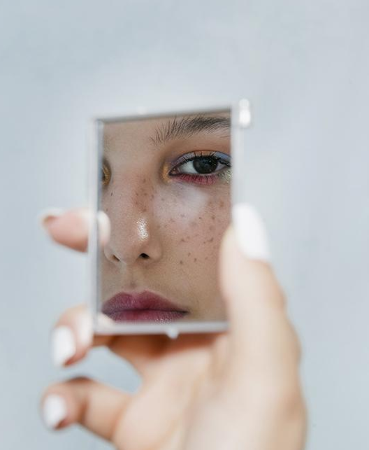
WHO ARE WE?
Data Science team at Sephora
WHO ARE YOU?
Social Media, Marketing and Management team at Sephora

Slide 3
1
2
AGENDA
3
4
INTRODUCTION
EDA
Background & Problem Statement
Data Cleaning & EDA
MODELING
CONCLUSION
Model Evaluation
Future Enhancement

Slide 4
01
Introduction

Slide 5
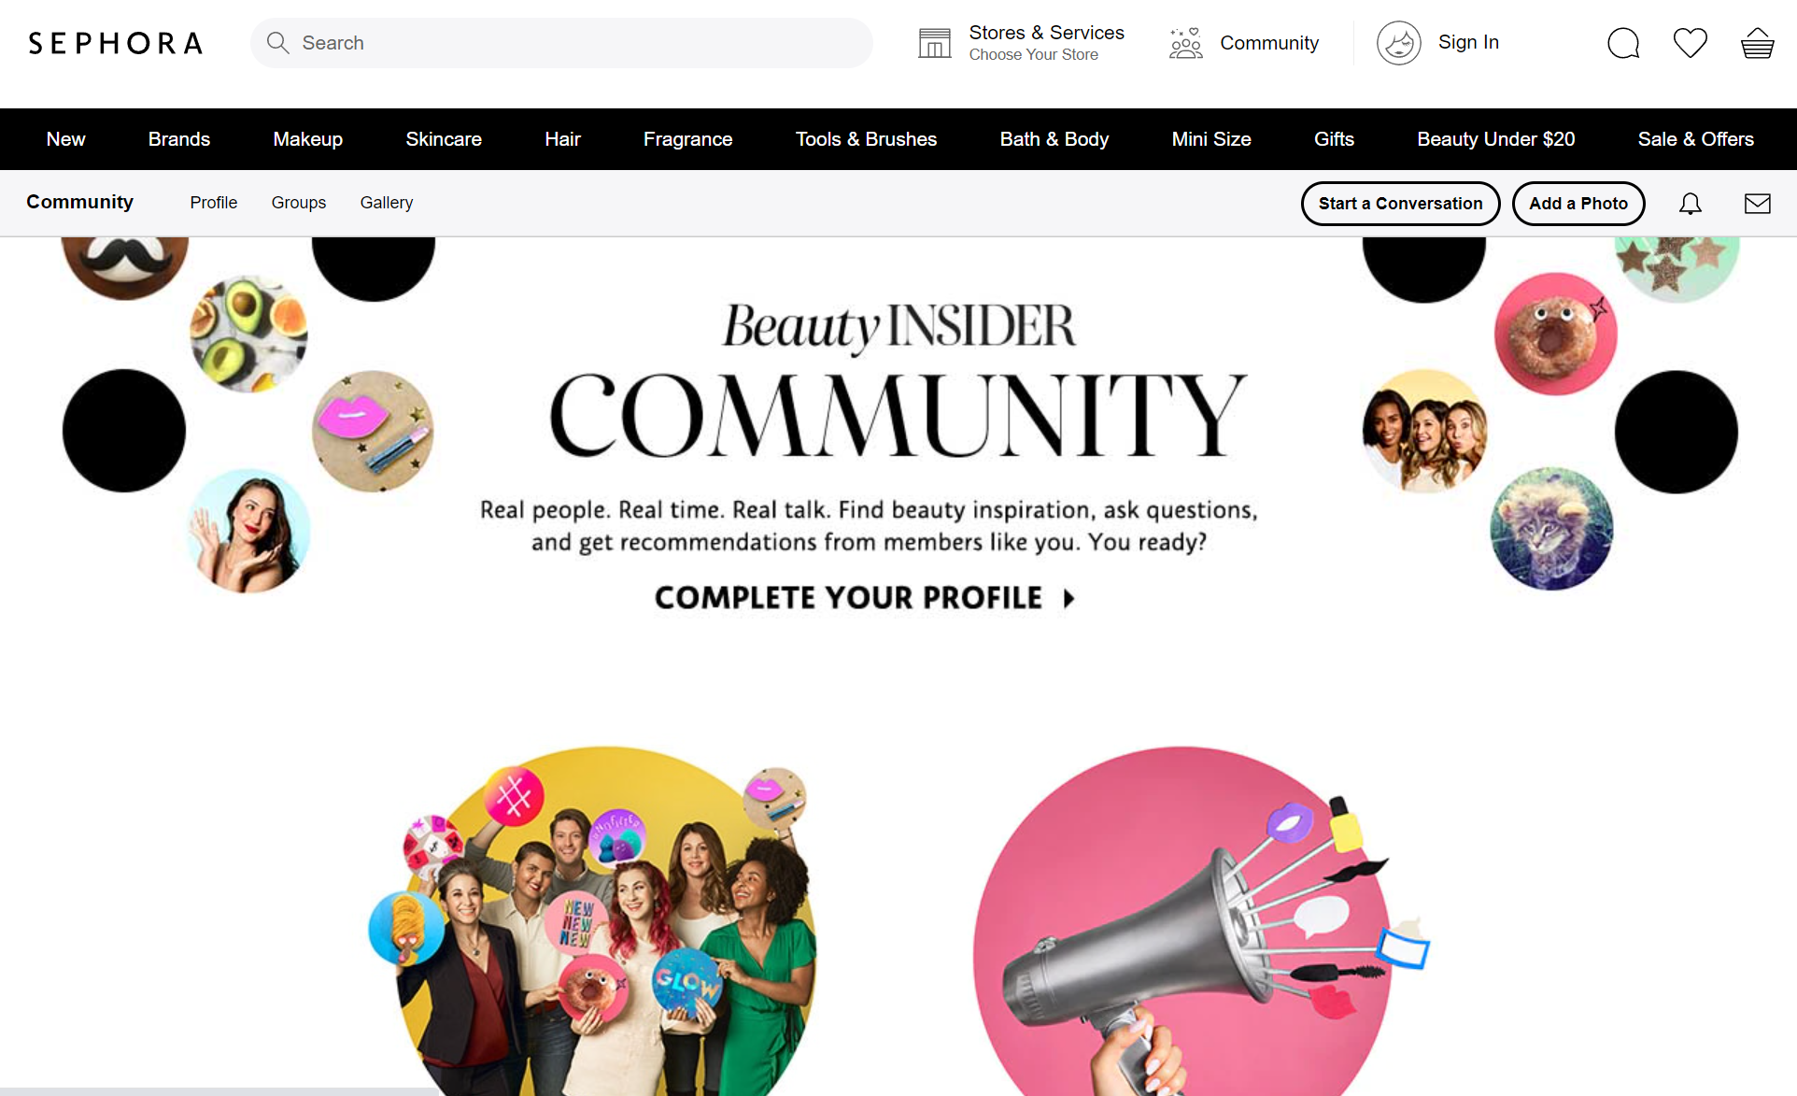
BACKGROUND
We have recently created our Sephora Beauty Insider Community Forum to help shoppers forge personal connections with like-minded beauty enthusiasts
Our marketing team has identified the forum as a way to obtain data and insights directly from our customers and improve our understanding of customers’ needs and wants.
From these insights, we can better market and improve our product line according to customers’ preferences and drive more sales.

Slide 6
PROBLEM STATEMENT
Our Social Media department has informed us that users of our newly created Sephora Beauty Insider Community Forum have been posting in the wrong group.
The makeup and perfumes posts are posted in the General Discussion page and we need to find a way to classify their posts into Makeup and Perfumes categories for better analysis of their needs and interests.

Slide 7

OBJECTIVES
Use Reddit posts from r/Makeup and r/Perfumes to create a text classifier model that can classify posts into the 2 categories with accuracy more than 50% (baseline accuracy).
We can then use the model to classify the posts in our Sephora forum.
Find out the trending words in each subreddit to guide our marketing department

Slide 8
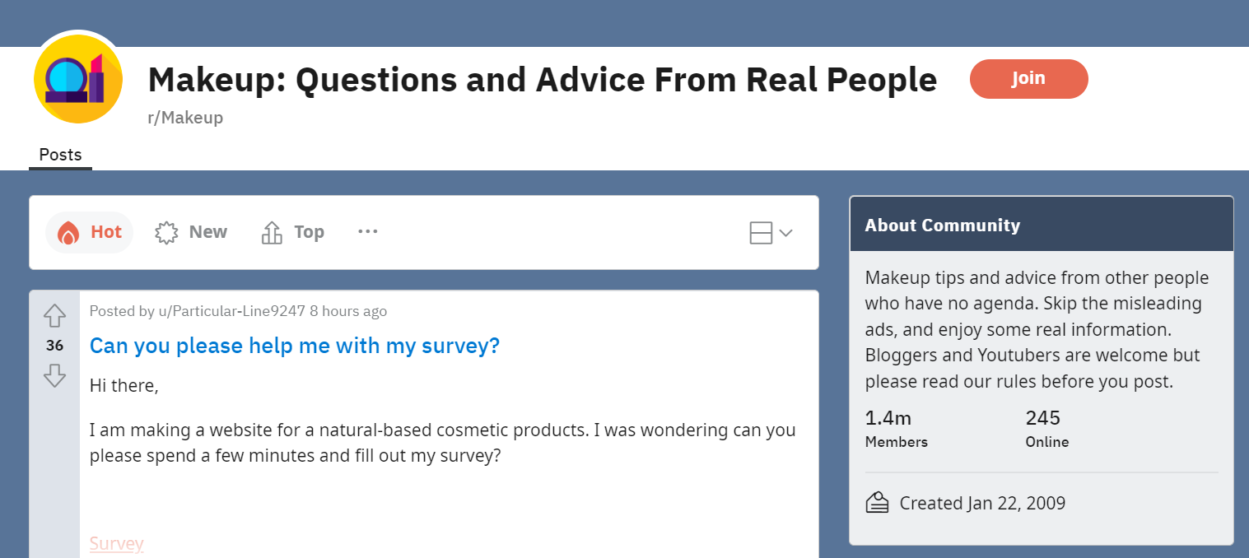
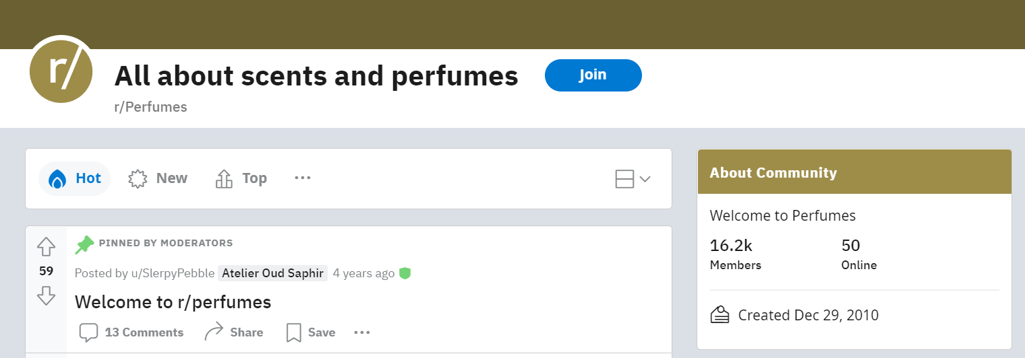
SUBREDDITS
r/Makeup
1.4m members
Community where people share makeup tips and advice
r/Perfumes
16.2k members
Community where people discuss about scents and perfumes

Slide 9
DATA COLLECTION
We used Pushshift's API to scrape posts from each of the two subreddits
r/Makeup - 5000 most recent posts dating back to April 12, 2022
r/Perfumes - 5000 most recent posts dating back to January 13, 2021
We kept columns ‘Subreddit’, ‘Title’ and ‘Selftext’ which contain the category and text required for our EDA and modelling.

Slide 10
02
Data Cleaning

Slide 11
DATA CLEANING
Combine the title and selftext columns
Remove words such as “[removed]”, “[deleted]”, “NaN”
Remove punctuations
Tokenize the posts
Remove stop words such as “I”, “we”, “and” etc
Lemmatize the words
Remove words with numbers, non-english words & additional stopwords

Slide 12
02
Exploratory
Data Analytics
(EDA)

Slide 13
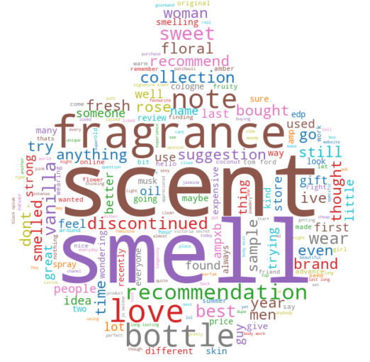
MOST COMMON WORDS
Perfume Subreddit:
Scent
Smell
Fragrance
Love
Bottle
Note

Slide 14
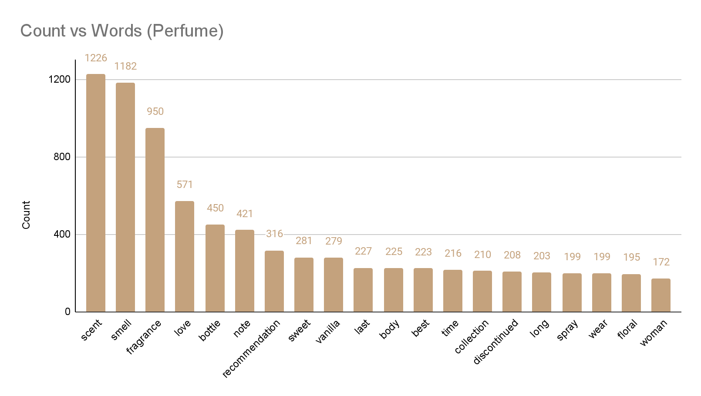
MOST COMMON WORDS

Slide 15
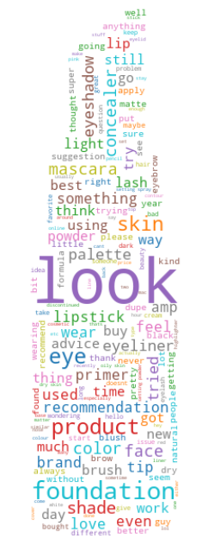
MOST COMMON WORDS
Makeup Subreddit:
Look
Foundation
Skin
Eye
Product
Shade

Slide 16
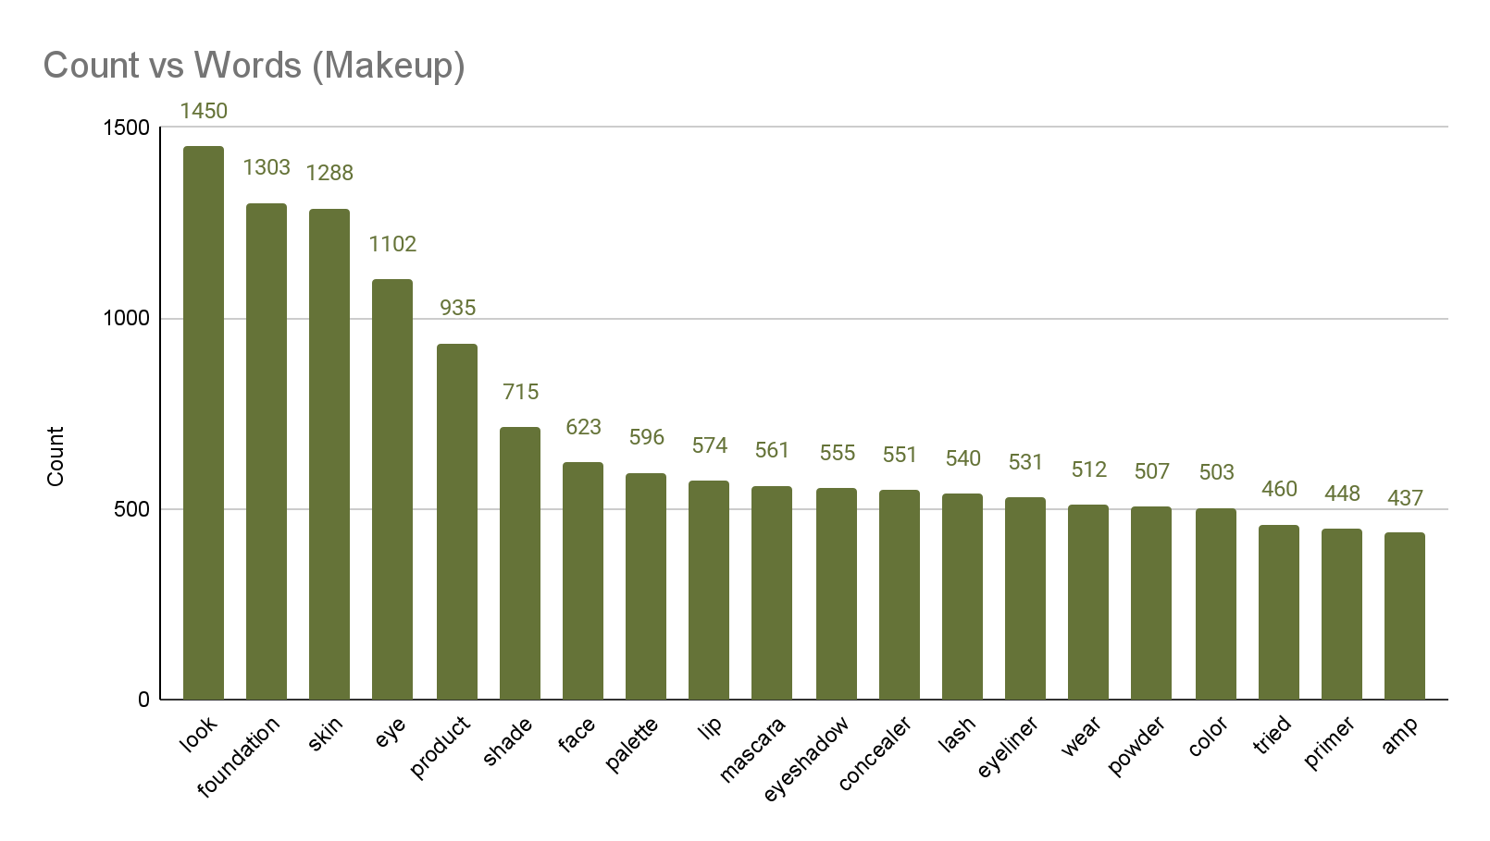
MOST COMMON WORDS

Slide 17
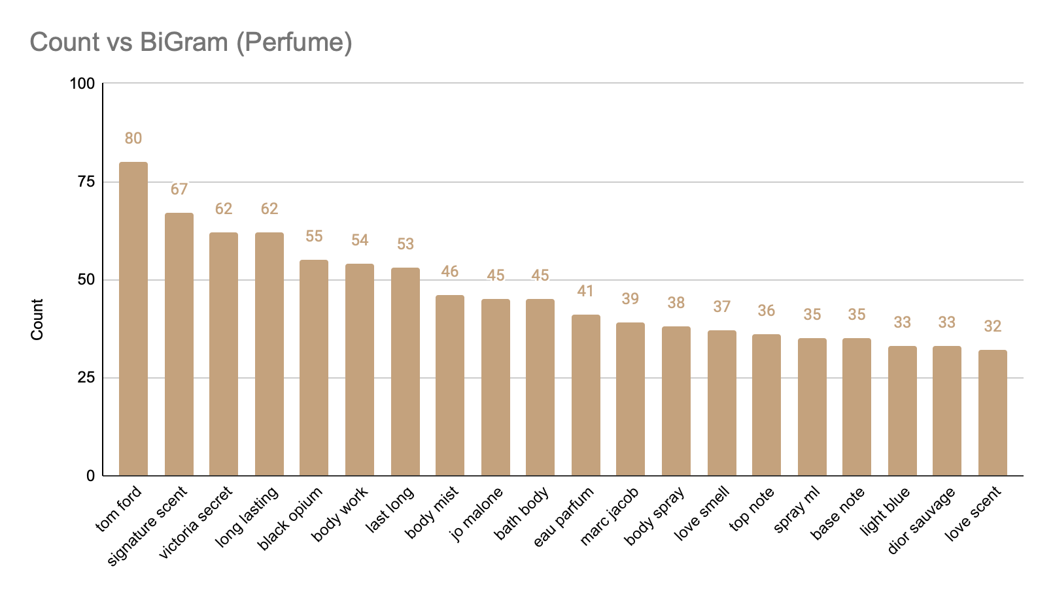
BIGRAM - PERFUME

Slide 18
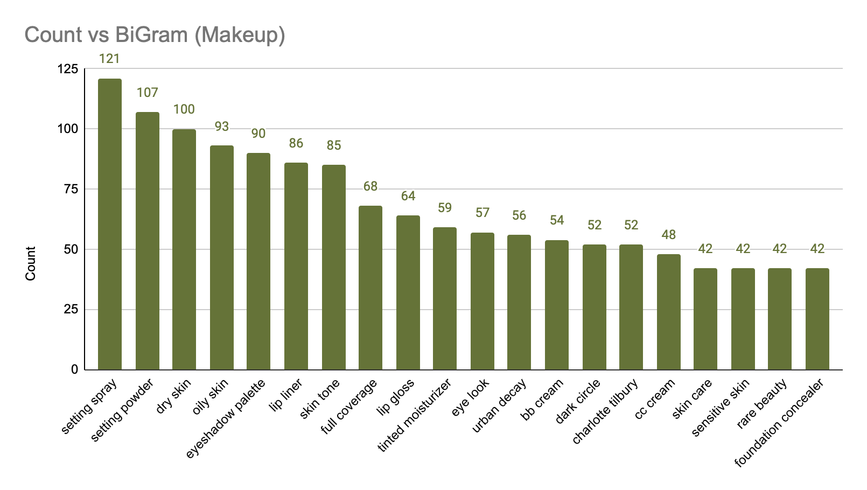
BIGRAM - MAKEUP

Slide 19
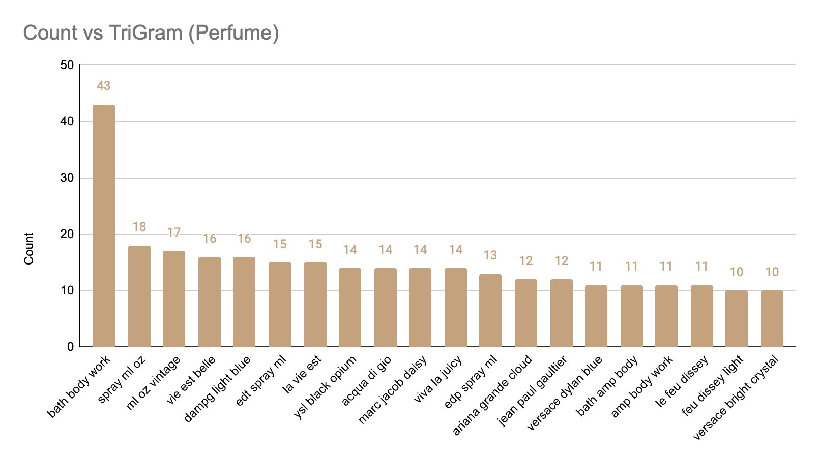
TRIGRAM - PERFUME

Slide 20
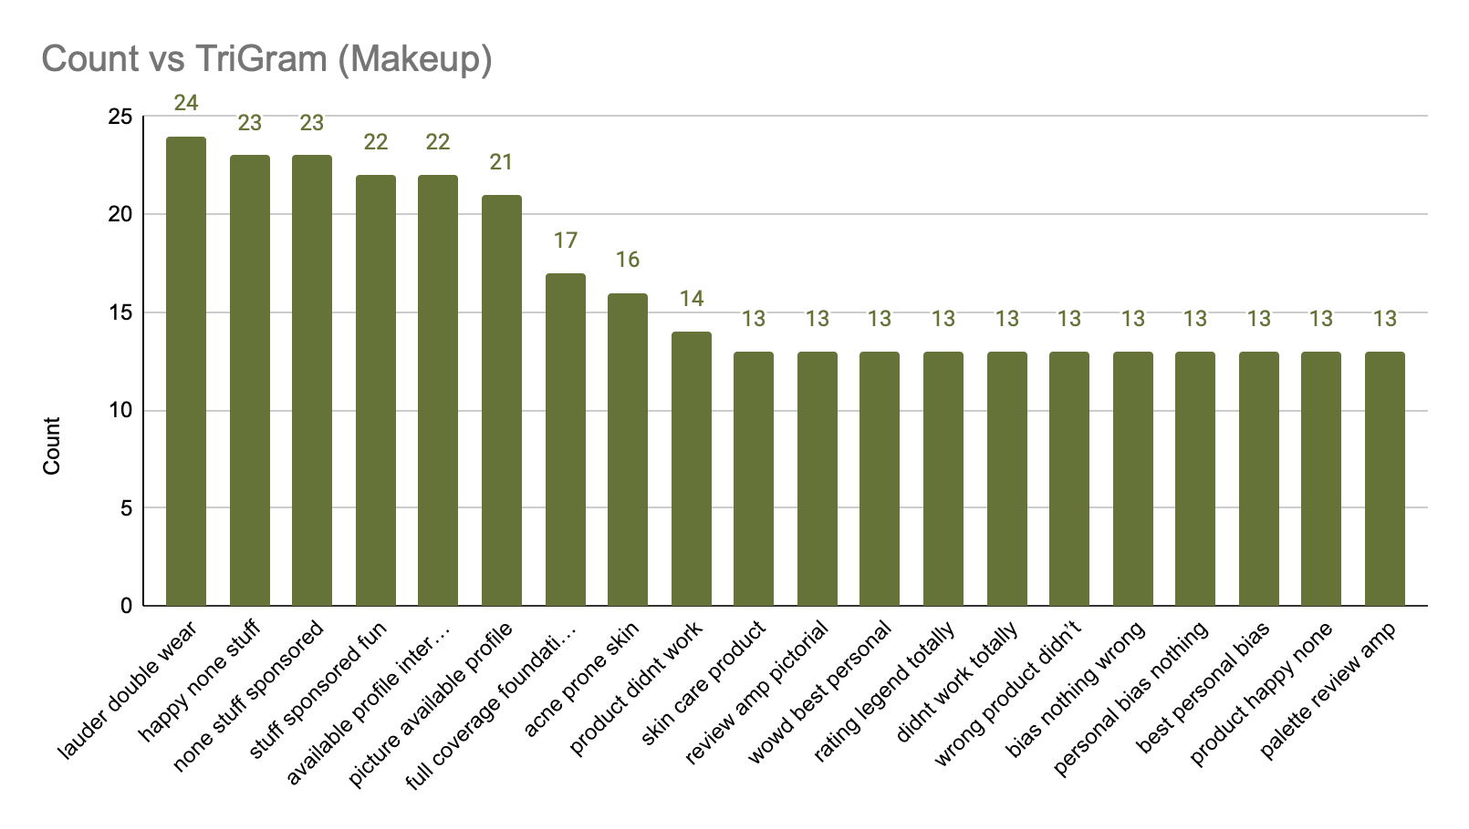
TRIGRAM - MAKEUP

Slide 21
RECOMMENDED BRANDS
PERFUMES:
Tom Ford
Victoria Secret
Black Opium
Jo Malone
Marc Jacob
Dior Sauvage
Bath & Body Works
D&G Light Blue
La Vie Est Belle
Viva La Juicy
Marc Jacobs daisy
Ariana Grande Cloud
Jean Paul Gaultier
Versace Dylan Blue
La Feu Dissy Light
Versace Bright Crystal

Slide 22
RECOMMENDED PRODUCTS
MAKEUP:
Setting Spray
Setting Powder
Eyeshadow Palette
Lip Liner
Lip Gloss
Tinted Moisturiser
Eye Look Makeup
BB Cream
CC Cream
Skin Care Products
Foundation Concealer
Full Covereage Foundation

Slide 23
RECOMMENDED FEATURES
PERFUME:
Long Lasting
Love Smell
Top Note
Base Note
MAKEUP:
Dry Skin
Oily Skin
Skin Tone
Dark Circle
Sensitive Skin
Acne Prone Skin

Slide 24
03a
Modelling

Slide 25
Model Selection
Goal: Classify posts by their group
Classification Models used:
  Bernoulli Naïve Bayes
  Multinomial Naïve Bayes
  Gaussian Naïve Bayes
  Logistic Regression
  K-Nearest Neighbour
Notes:
Vs. Statistical models - specific value

Slide 26
Vectorised Data Selection
Count
N-grams
  Bigrams
  Trigrams
TF-IDF
  Term Frequency-Inverse Document Frequency
Notes:
Separated words by different ways
TF-IDF (term frequency-inverse document frequency) is a statistical measure that evaluates how relevant a word is to a document in a collection of documents

Slide 27
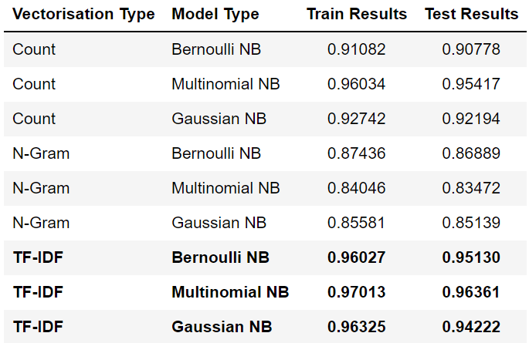
Vectorised Data Selection

Slide 28
Vectorised Data Selection

Slide 29
Vectorised Data Selection

Slide 30
Vectorised Data Selection
Notes:
Using TF-IDF dataset, we run more models

Slide 31
Model Optimisation
Model | Before | After
Bernoulli Naïve Bayes | binarize = 0.0 | binarize = 0.2
Multinomial Naïve Bayes | fit_prior = True | fit_prior = False
Gaussian Naïve Bayes | n/a | n/a
Logistic Regression | solver = ‘liblinear’ | n/a
K-Nearest Neighbour | n = 3 | n = 2

Slide 32
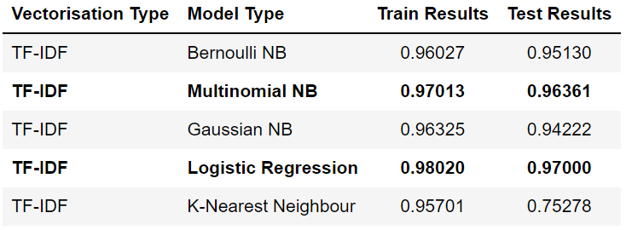
Model Evaluation

Slide 33
Model Evaluation
Notes:
Instead of relying solely on scores, dive deeper

Slide 34
03b
Model Comparisons

Slide 35
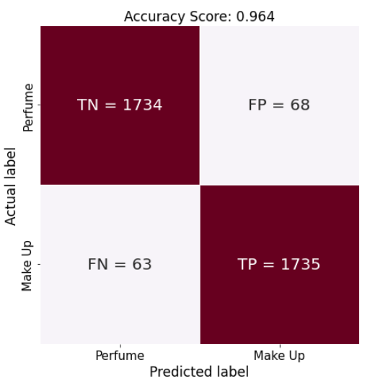
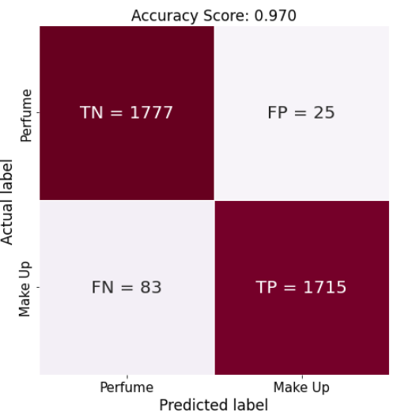
Confusion Matrix
Multinomial NB
Logistic Regression

Slide 36
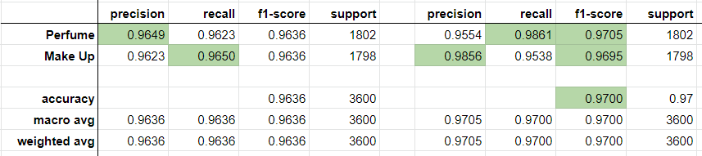
Classification Report
Multinomial NB
Logistic Regression
Notes:
LogReg higher variance

Slide 37
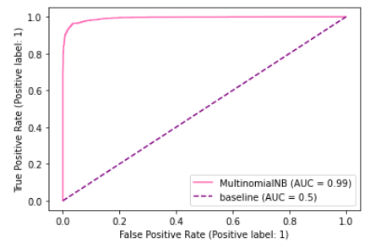
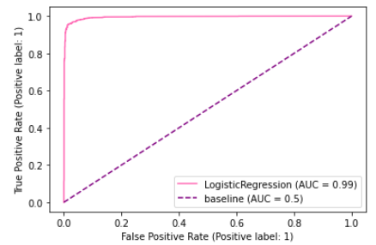
ROC Curve
Multinomial NB
Logistic Regression
Notes:
An ROC curve (receiver operating characteristic curve) is a graph showing the performance of a classification model at all classification thresholds.

Slide 38

Logistic Regression

Slide 39
06
Conclusion
Future Enhancement

Slide 40
Conclusion
Logistic Regression
Improve Efficiency and Effectiveness of Marketing & Social Media Team
Trending Words
Develop Marketing Strategies as per trending words
Top Predictors
Identify the key words that can improve our product and services

Slide 41
Future Enhancements
More Data
Update Stop Words
Sentiment Analysis
Social Media Platform: Facebook, Twitter, Instagram
Input less meaningful words into stop words list
On Comments section on our forum
Notes:
More data: - training data using irrelevant posts from more than one source (maybe facebook, twitter, instagram

Slide 42
THANKS!

